Slide 1
The Virtual Motherboard
and a Generic Virtual Bus
for
Hardware Simulator Composition

Slide 2
Hardware Simulation
To Test and Develop Hardware
To Test and Develop Software
  Hardware is not available
  Hardware is not suitable for debugging

Slide 3
Simulator Composition
Hardware is made of
  Off-the-shelf components
  Custom components
Simulators are made of
  Off-the-shelf components ?
  Custom components ?
  Monolithic Programms ?

Slide 4
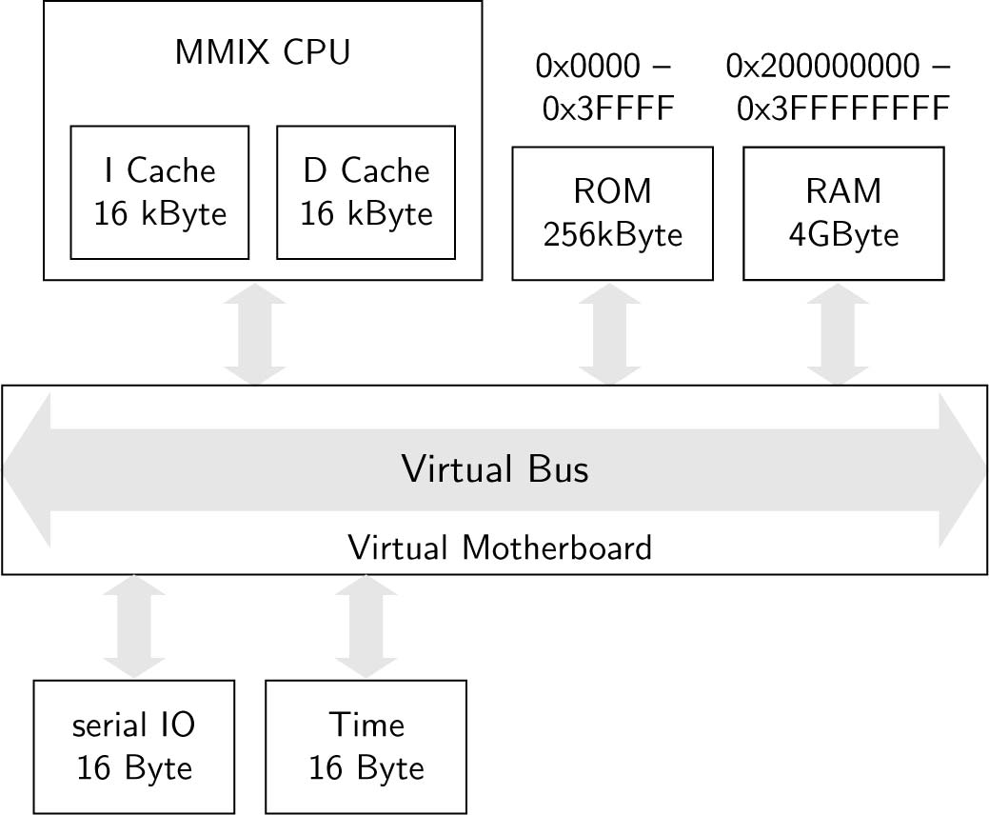
Virtual Motherboard
TCP/IP
Server
Client

Slide 5
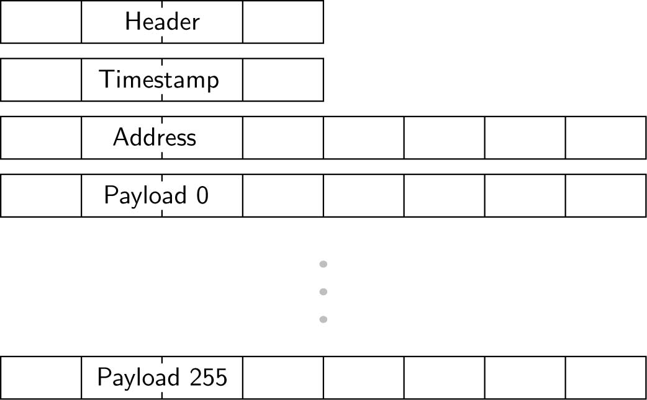
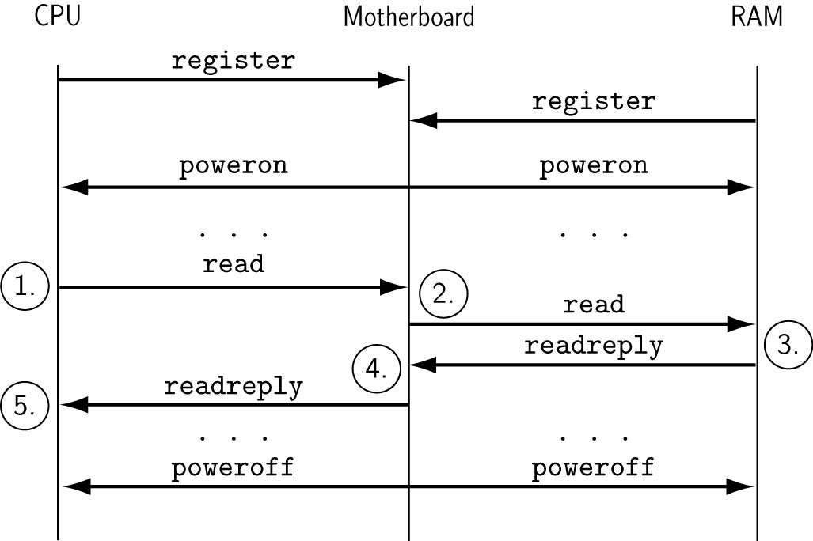
Virtual Bus over TCP/IP
Flexible Sequence
Simple Format

Slide 6
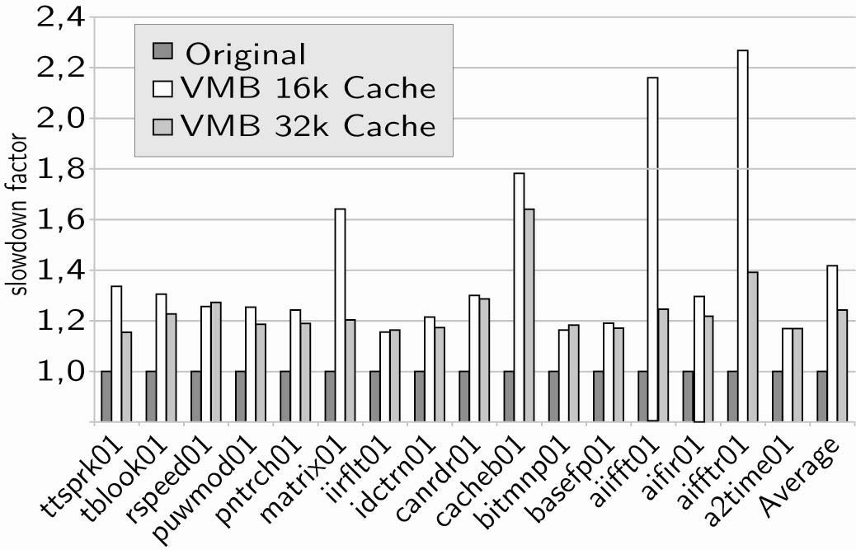
Flexibility and Performance
EEMBC automotive benchmark suite on MMIX CPU

Slide 7
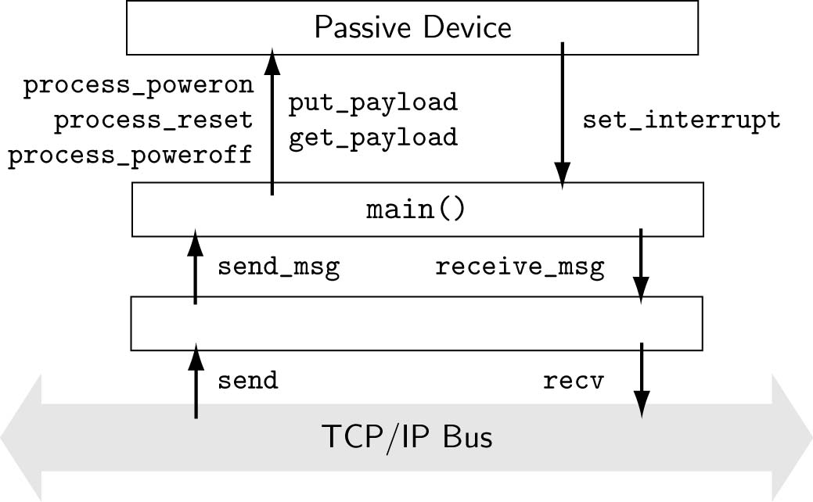
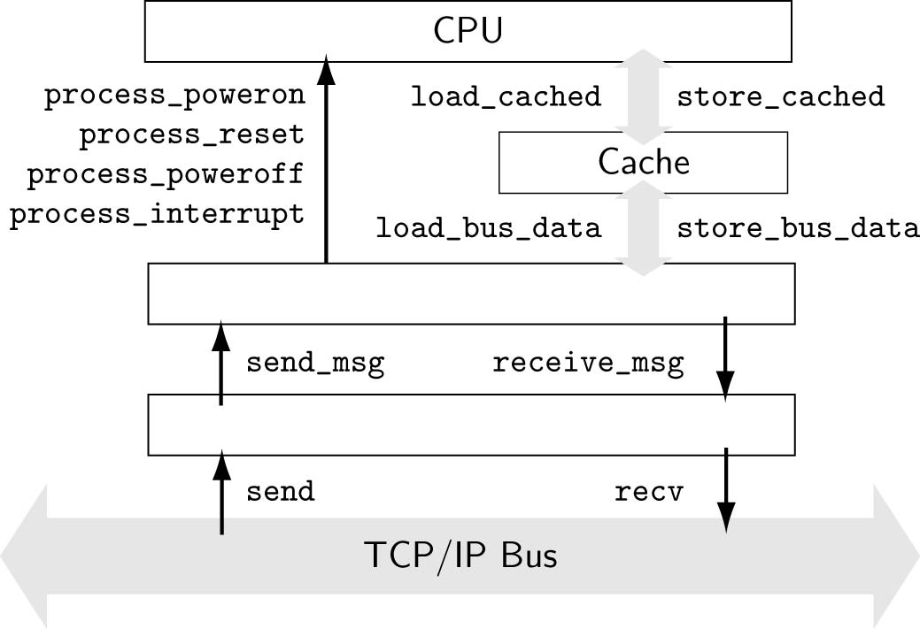
Simplicity and Abstraction the API
Address/Data Pairs
Atomic Events

